Slide 1
ACT India D&A GCC Assignment
Airline – Customer Satisfaction Prediction

Slide 2
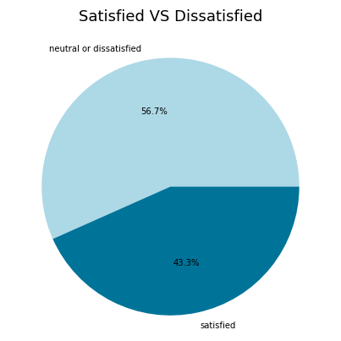
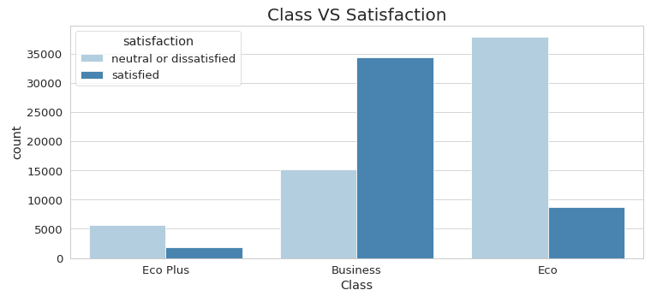
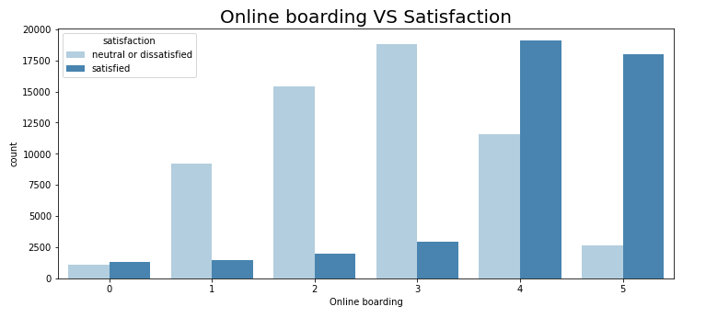
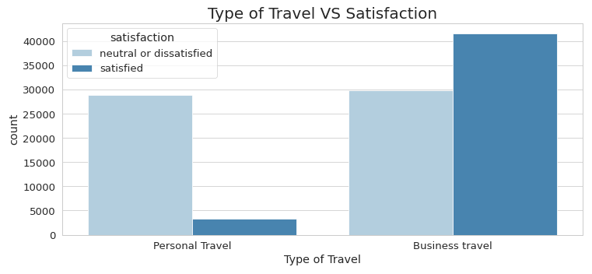
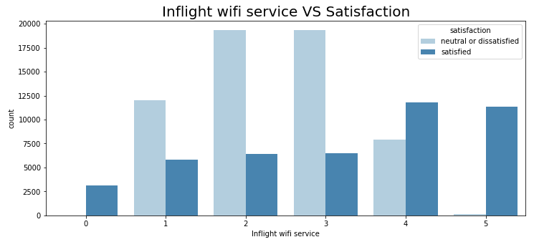

Slide 4
The sample is more or less balanced (56.7% on 43.3%).
The number of men and women in this sample is approximately the same.
The vast majority of the airline's customers are repeat customers.
Most of our clients flew for business rather than personal reasons.
About half of the passengers were in business class.
More than 60% of passengers were satisfied with the luggage transportation service (rating 4-5 out of 5).
More than 50% of passengers were comfortable sitting in their seats (rated 4-5 out of 5).
There was a strong correlation (96%) between the features 'Departure delay in minutes' and 'Arrival delay in minutes' (which is quite logical and was discussed in detail above).
Most of the airline's regular customers are between the ages of 30 and 50 (averaging a little over 40). The age range for non-regular customers is slightly smaller (from 25 to 40 years old, with an average of slightly less than 30).
Customers whose flight distance is long tend to fly in business class.
The more distance an airplane passenger travels (respectively, the longer they are in flight), the more satisfied they are with in-flight entertainment and extra legroom (on average).
Most of the passengers who flew in Economy Plus or Economy Class were dissatisfied with the flight, and those who were lucky enough to fly in Business Class were satisfied.
Almost all passengers who rated the wifi service 5 out of 5 were satisfied with the flight.
The majority of passengers who rated the comfort of the seats and the extra legroom at 4 and 5 points out of 5 were satisfied with the flight.

